Slide 1
Neural Induction

Slide 2
Topics
Some basic cell biology review
Early human/mammalian development
Stem cell potency and epigenetics
Developmental modes in model organisms
Early neural induction experiments
Neural inducers and pathways

Slide 3
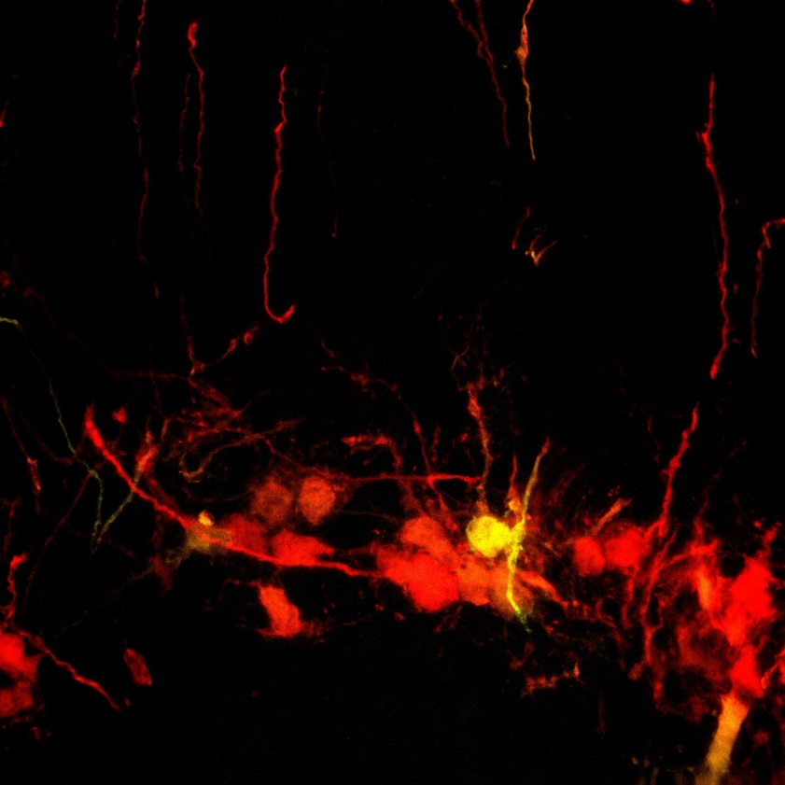
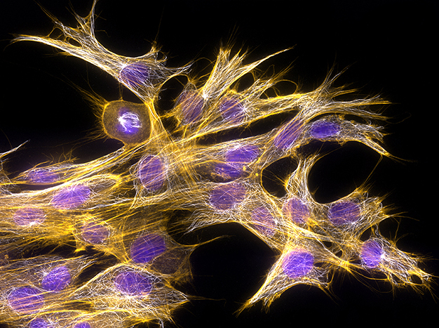
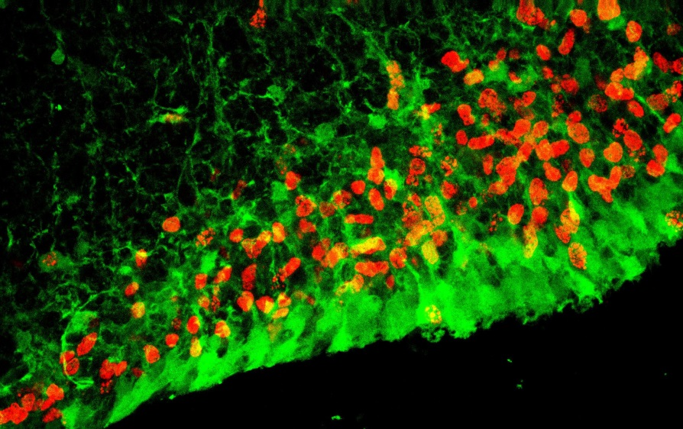
The Cell
Dr. Torsten Wittmann/Science Source.

Slide 4
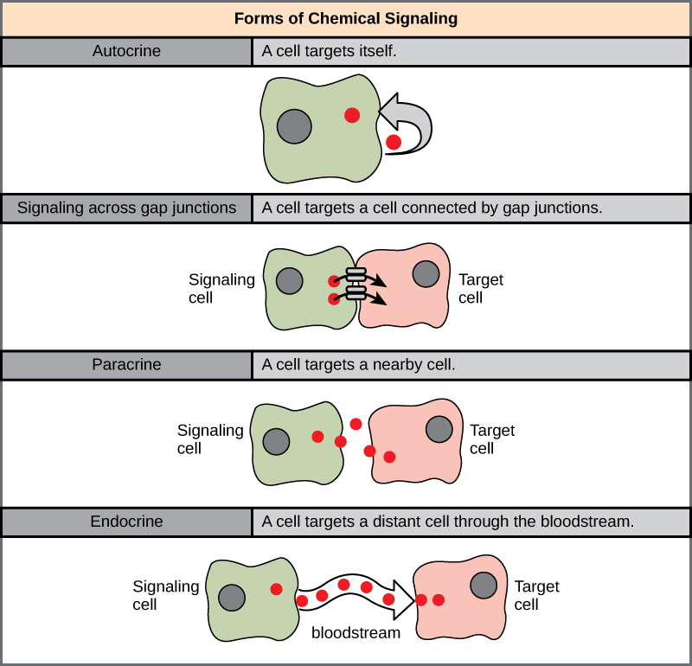

Slide 5
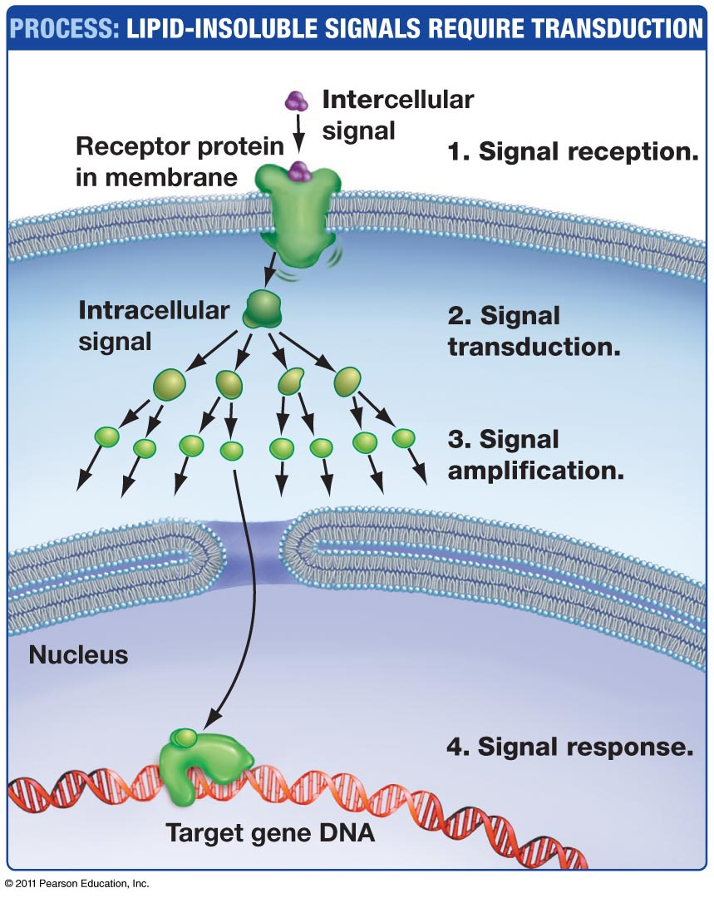

Slide 6
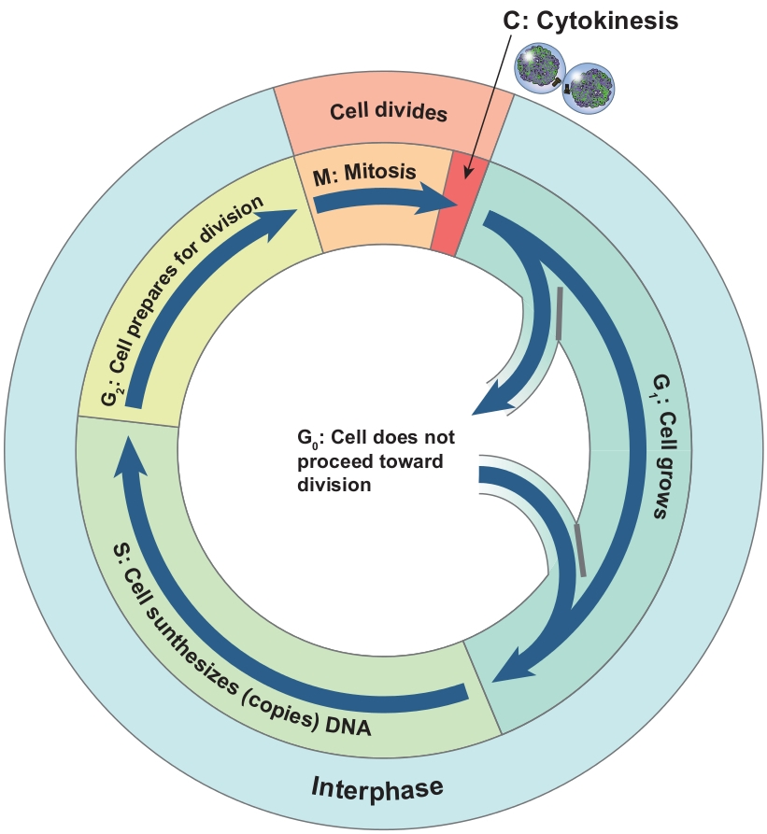
The cell cycle
Cell cycle consists of four phases: G₁, S, G₂, and M. Together, G₁, S, and G₂ phases between mitosis are known as interphase.
In M (mitosis) phase, chromosomes are partitioned to two sides of the cell and the cell divides into two daughter cells.
In G₁ (first growth) phase, cell grows and synthesizes proteins.
In S (synthesis) phase, cell replicates its DNA; that is, the chromosomes are duplicated.
In G₂ (second growth) phase, cell grows further and prepares for mitosis.
Non-dividing cells can also enter into a special G₀ phase.

Slide 7
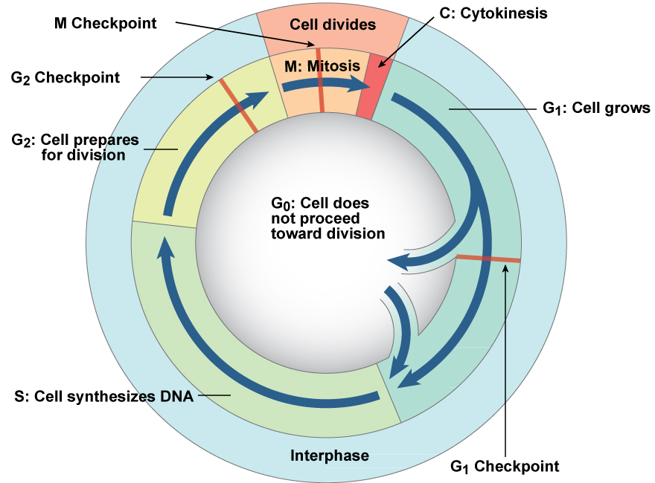
Cell cycle checkpoints
Progression through the cell cycle is controlled by checkpoints. Cells that do not divide do not pass the G₁ checkpoint and remain in G₀. Once a cell passes the G₁ checkpoint, it is usually committed to complete mitosis. Cells with DNA or chromosome damage will fail to pass the G₂ or M checkpoints.

Slide 8
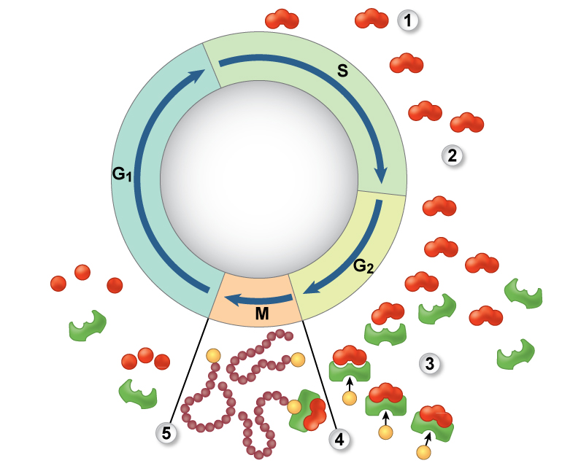
Cyclins
Class of proteins whose concentration depends on cell cycle phase. Cyclins bind to and activate cyclin-dependent kinases (Cdks), which phosphorylate other proteins involved in cell cycle. Maturation-promoting factor (MPF) is a cyclin-Cdk complex that participates in enzyme activation, nuclear envelope breakdown, and chromosome condensation.

Slide 9
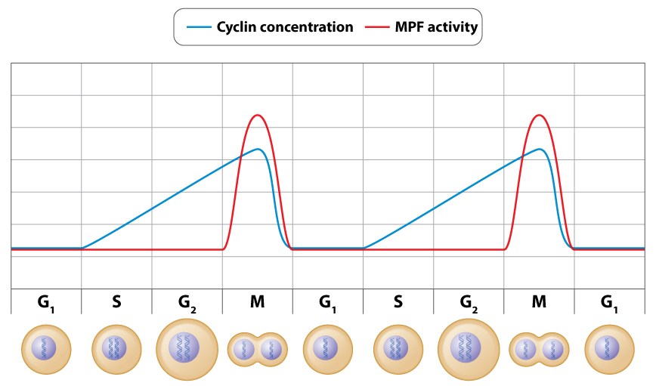
Cyclins and MPF
Cyclin and MPF levels peak at M phase. Cyclin levels rise steadily starting at S phase.

Slide 10
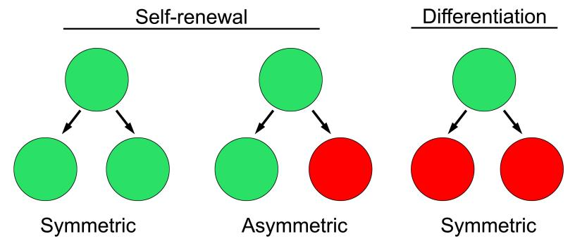
Self-renewal vs Differentiation

Slide 11
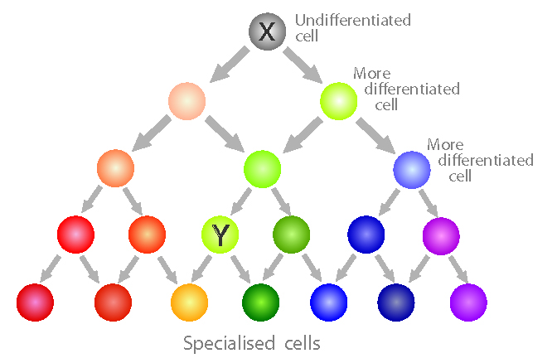
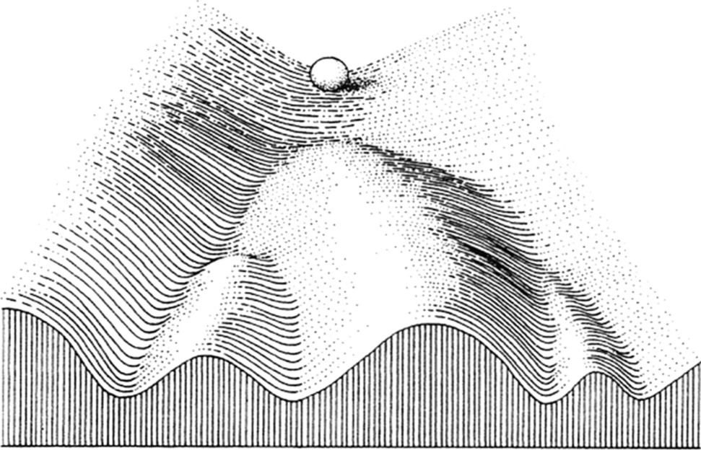
Differentiation

Slide 12
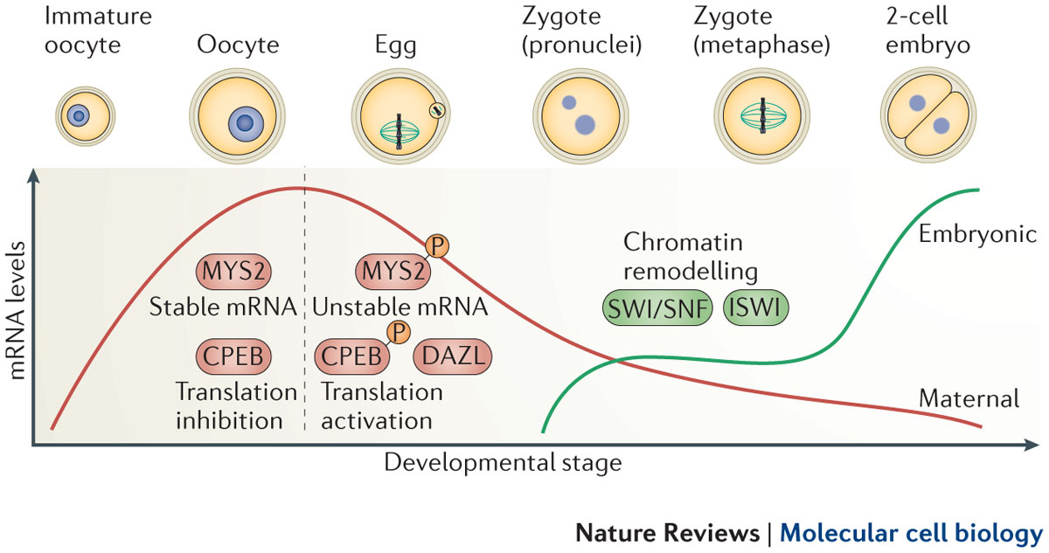
Transitioning from oocyte to embryo

Slide 13
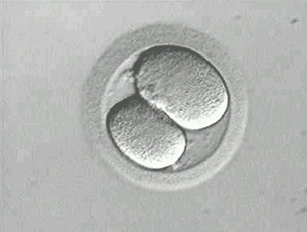
2 Cell Stage
Each cell at this stage can give rise to an entire human offspring.
Are these cells identical?

Slide 14
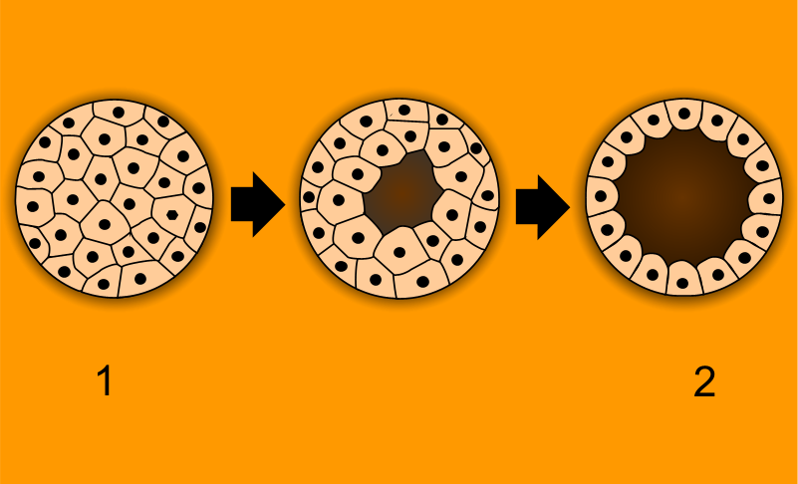
The Morula
Blastomeres in a solid ball surrounded by a zona pelucida
3rd-5th cell divisions, up to 32 cells
A cavity forms inside, blastocyst

Slide 15
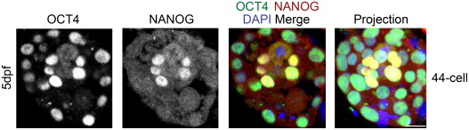
Mosaic Gene Expression
Somewhere between 16 cell and 64 cell stage, differential expression of genes is turned on.
This suggests that not every cell at this stage is equal. Twinning is no longer possible.
The first morphological differentiation is being set up: the blastocyst.

Slide 16
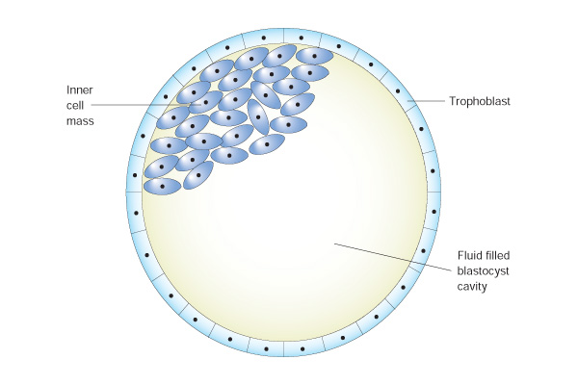
Differentiated Cells
Trophoblast
  Outer layer, provide the support structures for the embryo
  Important for proper implantation
Blastocoel
  Provides nutrients for the expanding ICM
Inner Cell Mass
  Gives rise to the embryo
  Initially only about 50 cells
  Begin to differentiate into new cell types
Fertilization to hatching

Slide 17
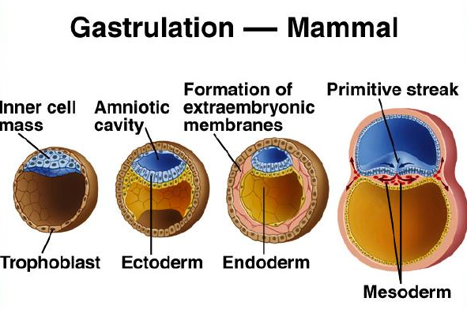
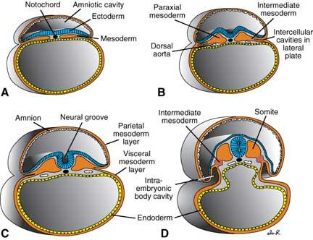
Gastrulation
The formation of the three primary germ layers:
  Ectoderm: epidermis, neural crest and nervous system
  Endoderm: epithelium of GI tract and respiratory system and organs
  Mesoderm: muscle and cartilage, cardiovascular system

Slide 18
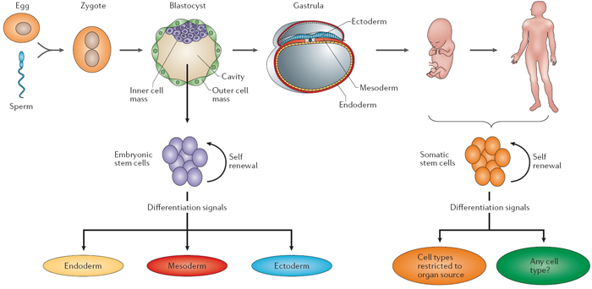
Pluripotent vs Multipotent

Slide 19
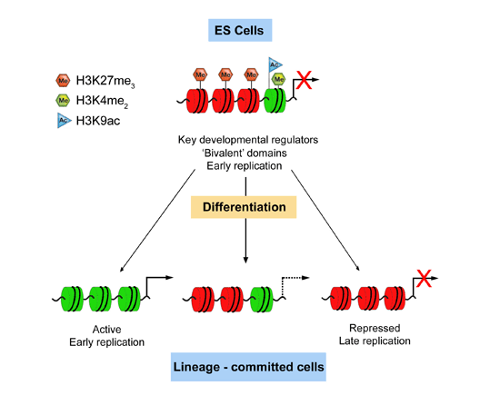
Epigenetics: Chromatin Remodeling
Modification of chromatin for transcription
Histones wrap up DNA and some histones can prevent or promote transcription
Histones can be modified :
  Phosphorylation
  Acetylation
  Methylation
Chromatin remodeling

Slide 20
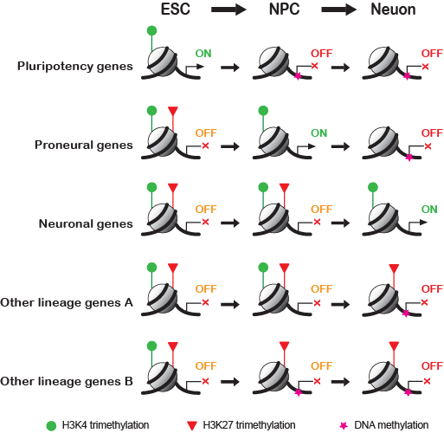
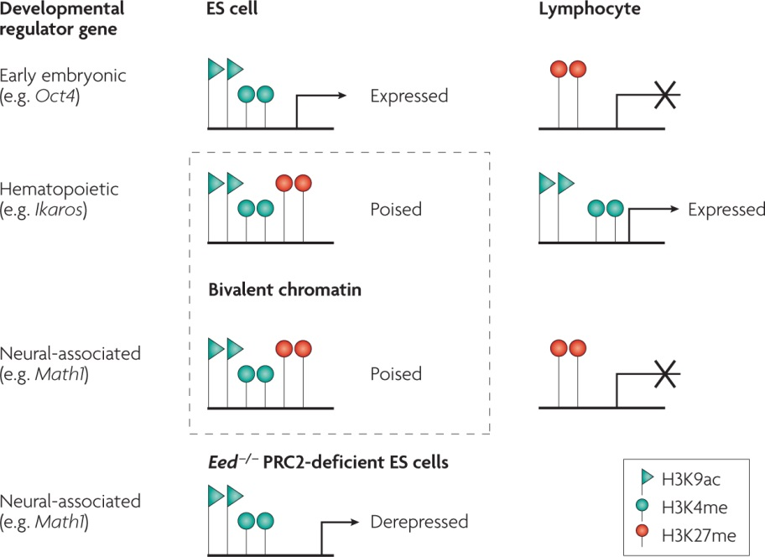
Somatic vs Pluripotent Chromatin

Slide 21
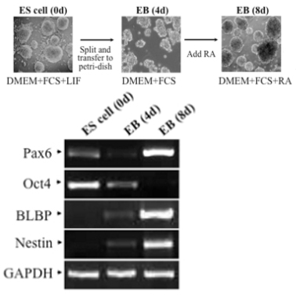
Changes in Gene Expression

Slide 22
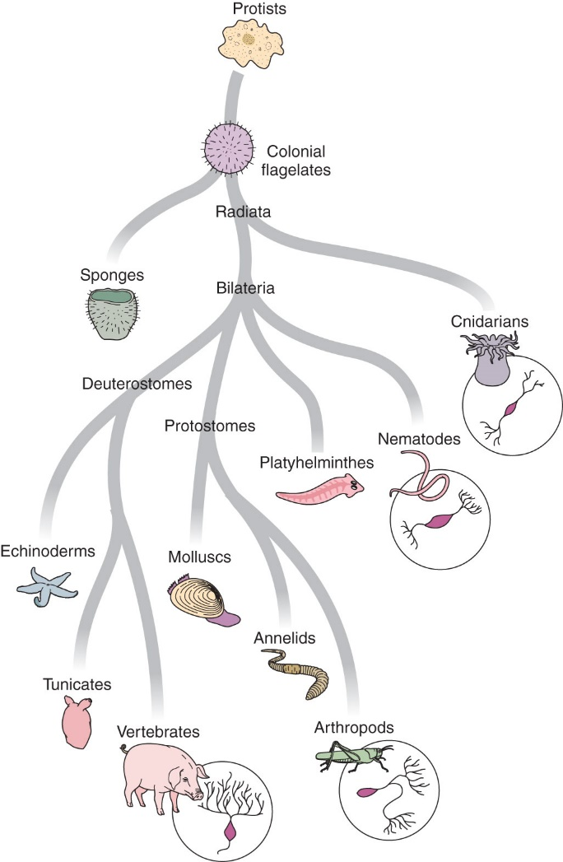
Diversity of Nervous Systems in Animals

Slide 23
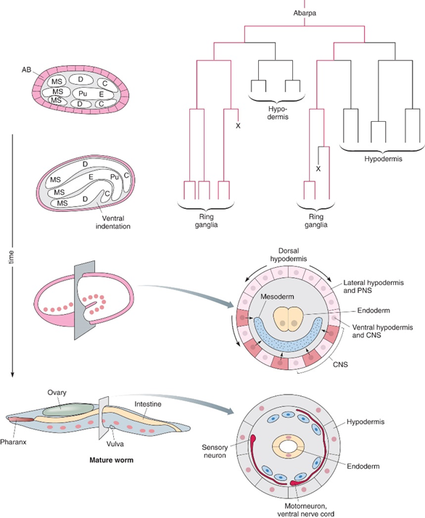
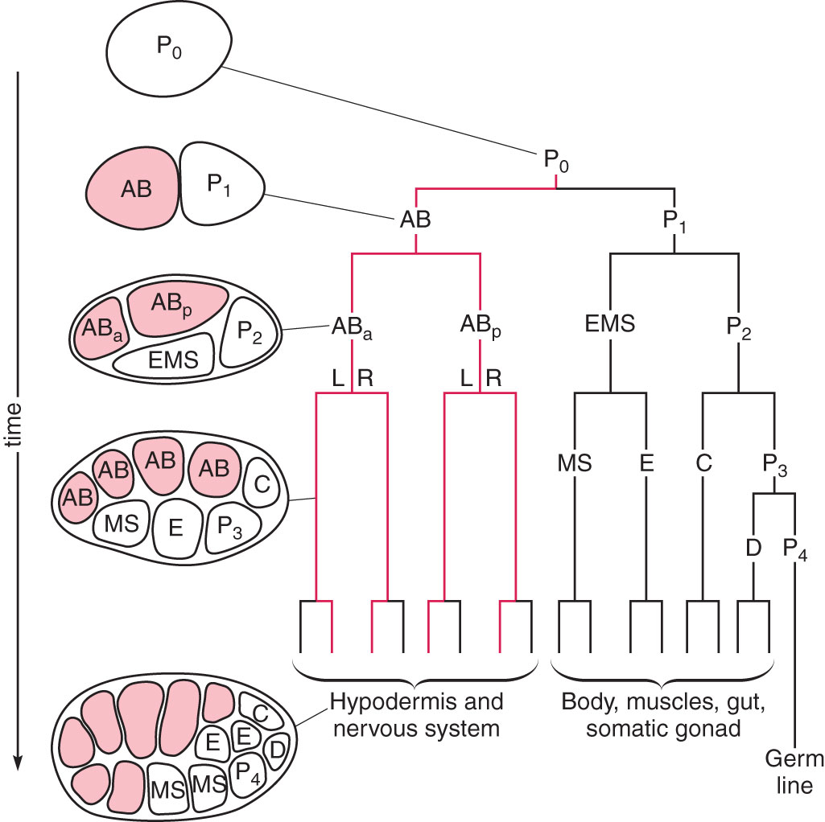
Mosaic Development in C. elegans

Slide 24
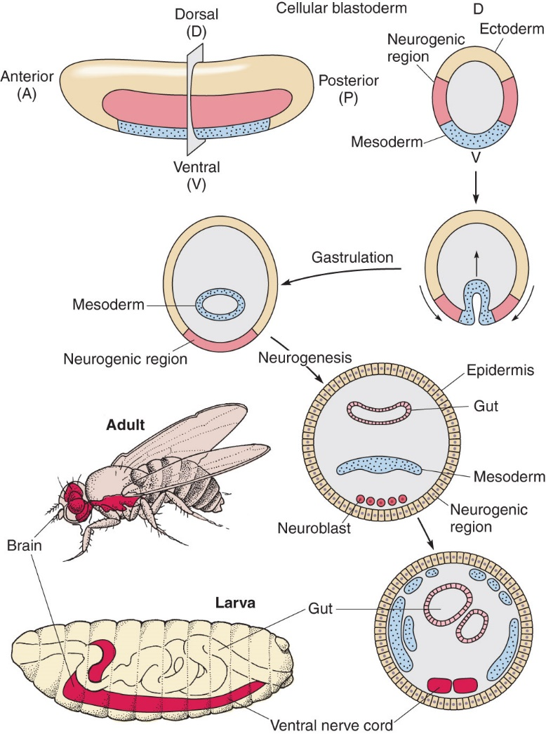
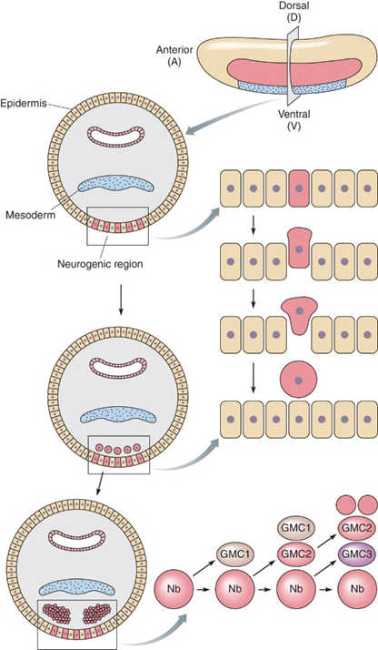
Regulative Development in Drosophila

Slide 25
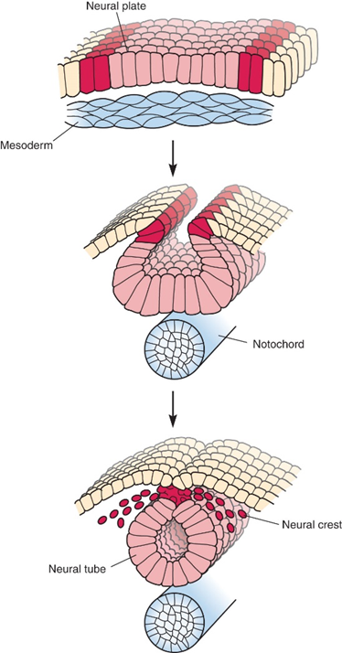
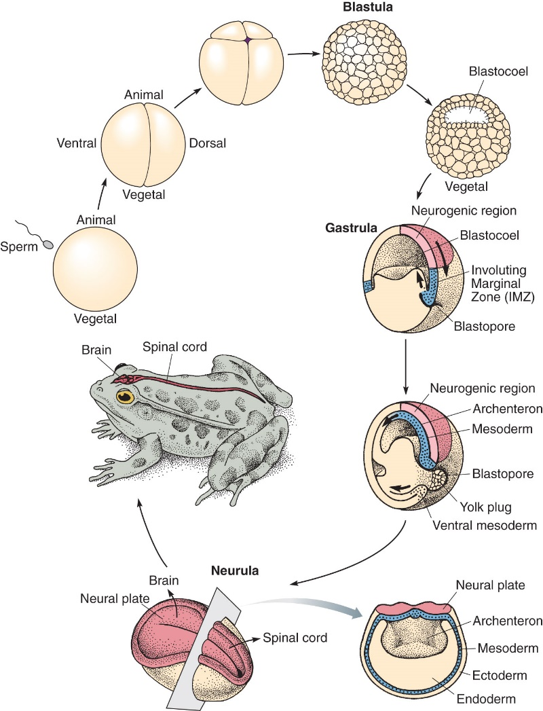
Early Vertebrate Development

Slide 26
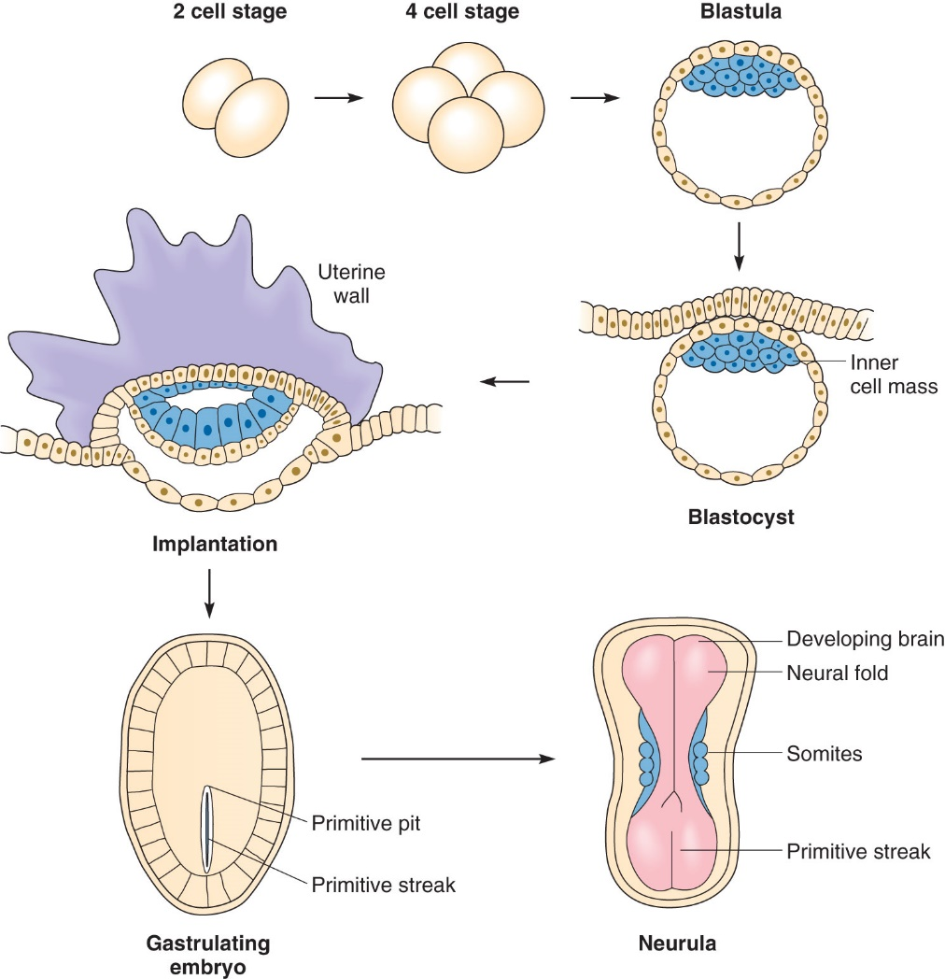
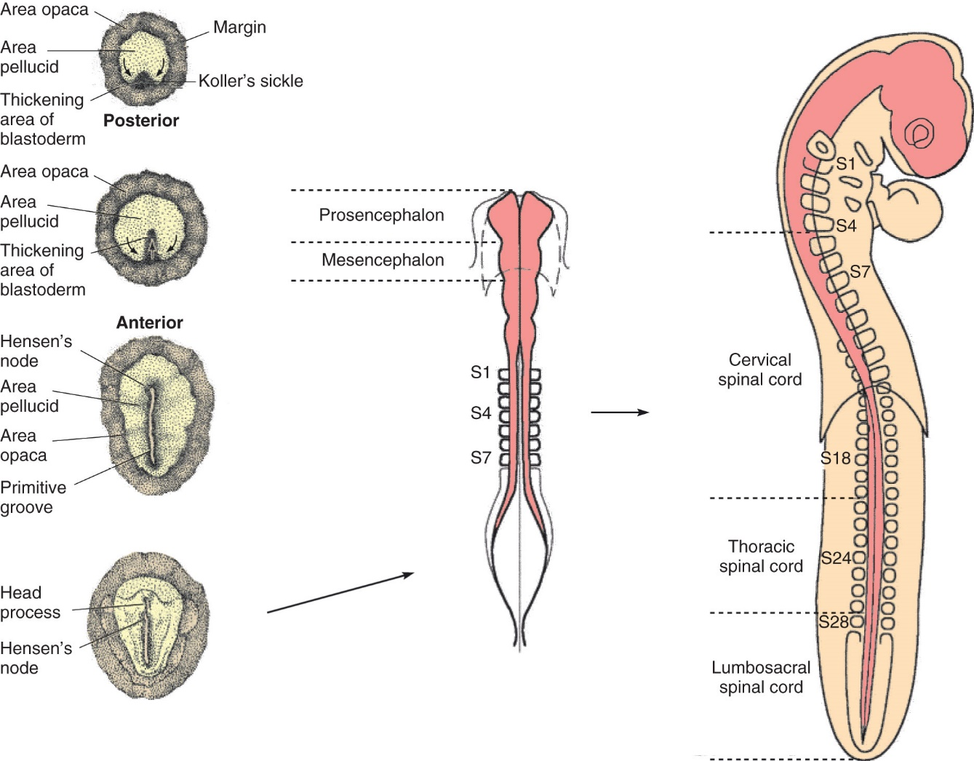

Slide 27
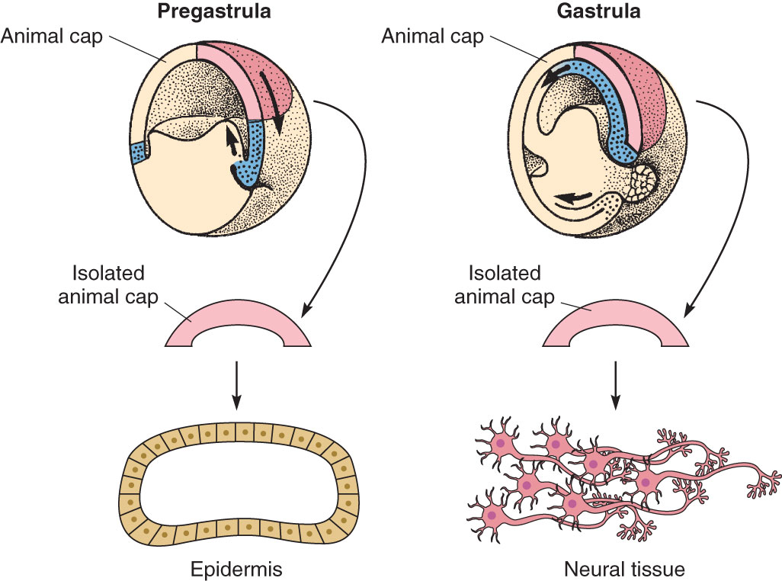
Interactions with Neighboring Tissues

Slide 28
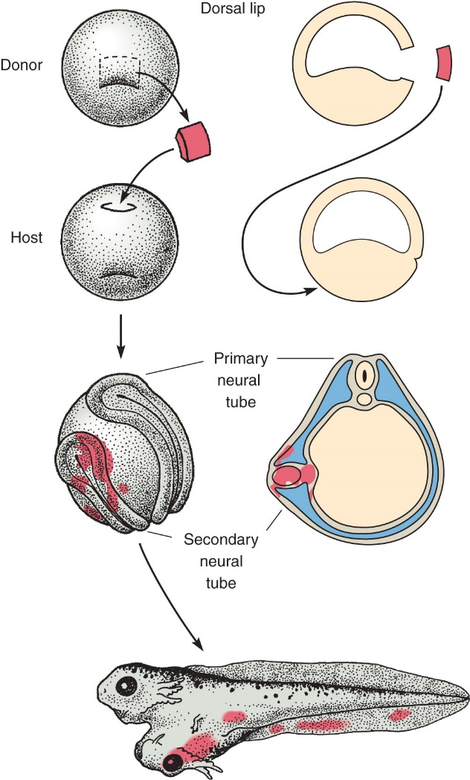
Spemann-Mangold Organizer
3 Primary germ layers form through gastrulation
Culturing small pieces in isolation showed fate potential
Do neighboring areas induce fate specification?
If so, what is being secreted?

Slide 29
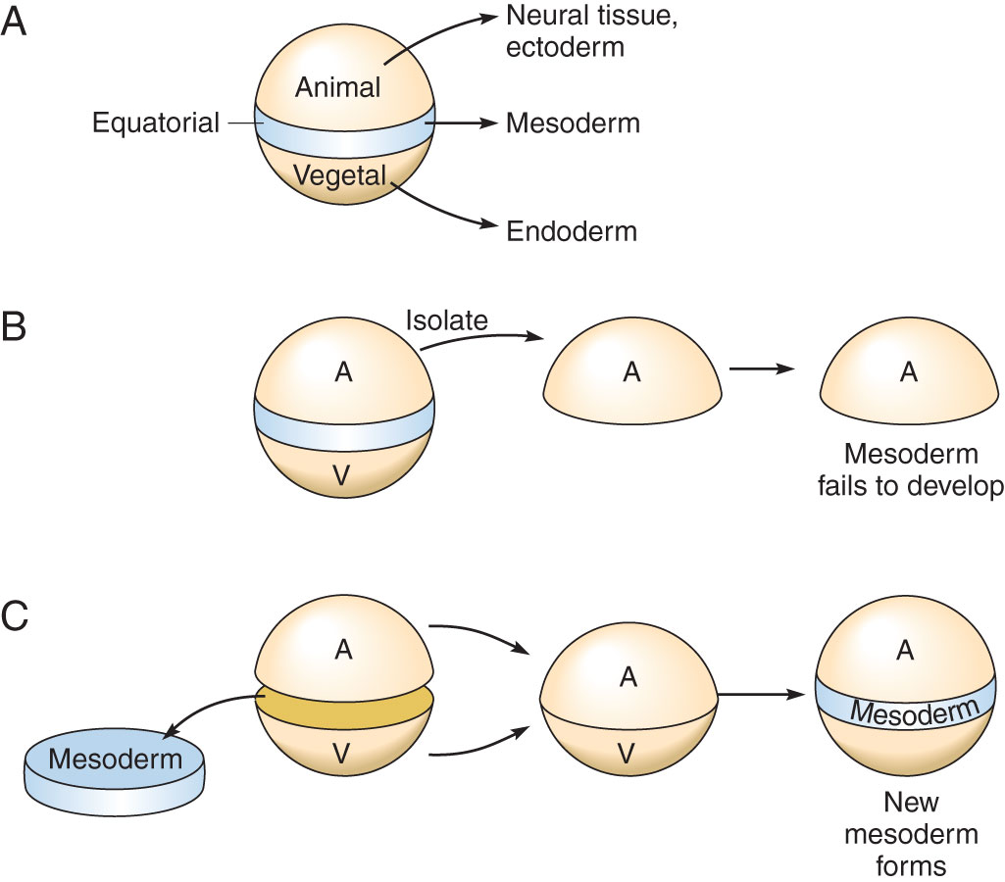
Peter Nieuwkoop’s basic induction assays
In isolation, mesoderm fails to develop
Without mesoderm, neural tissue does not form from the animal cap.
The vegetal cap is providing something that initiates mesoderm formation.

Slide 30
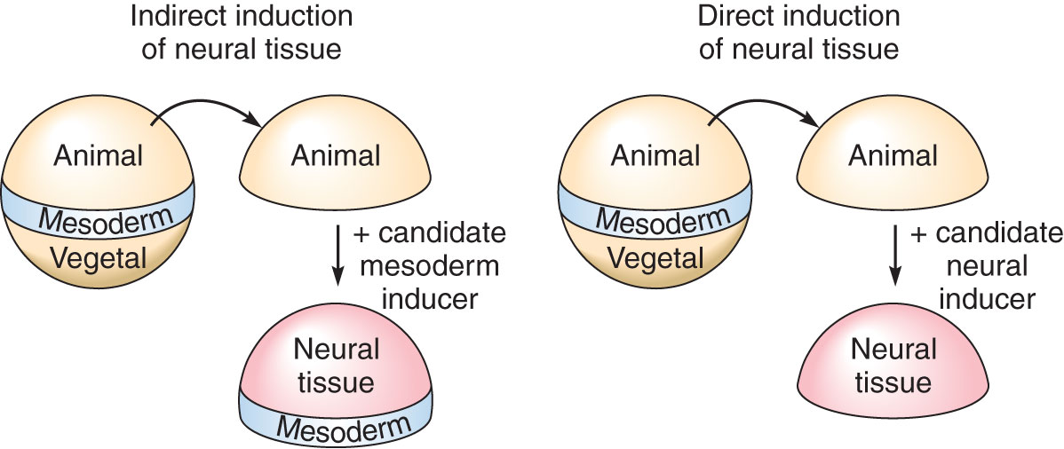

Slide 31
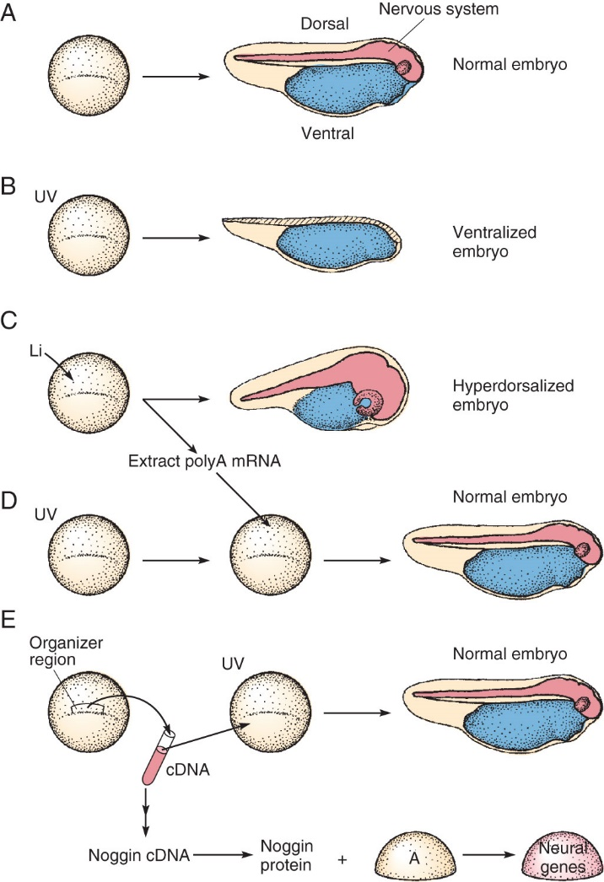
The identification of Noggin

Slide 32
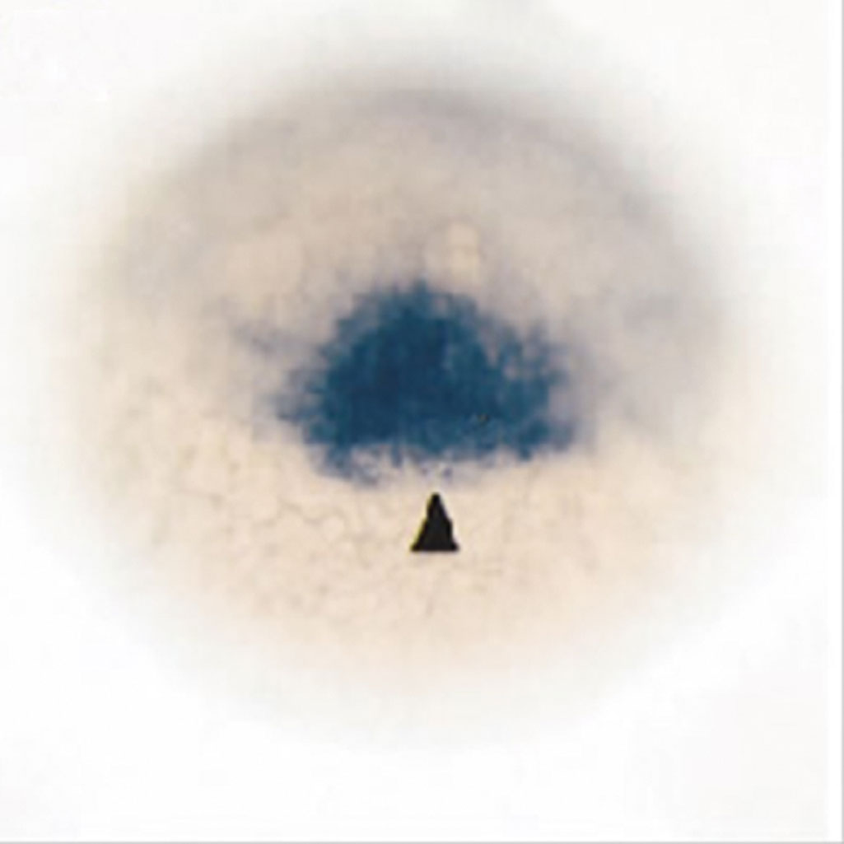
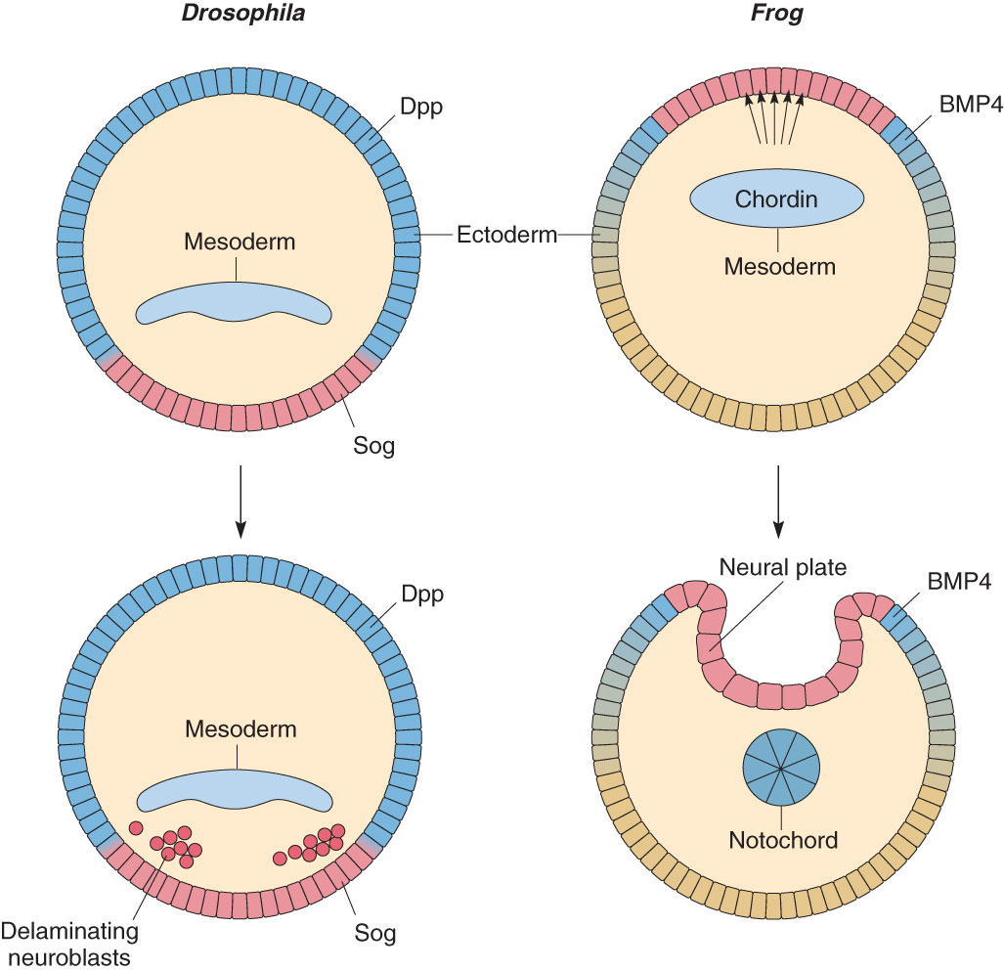
2 major neural inducers: chordin and noggin

Slide 33
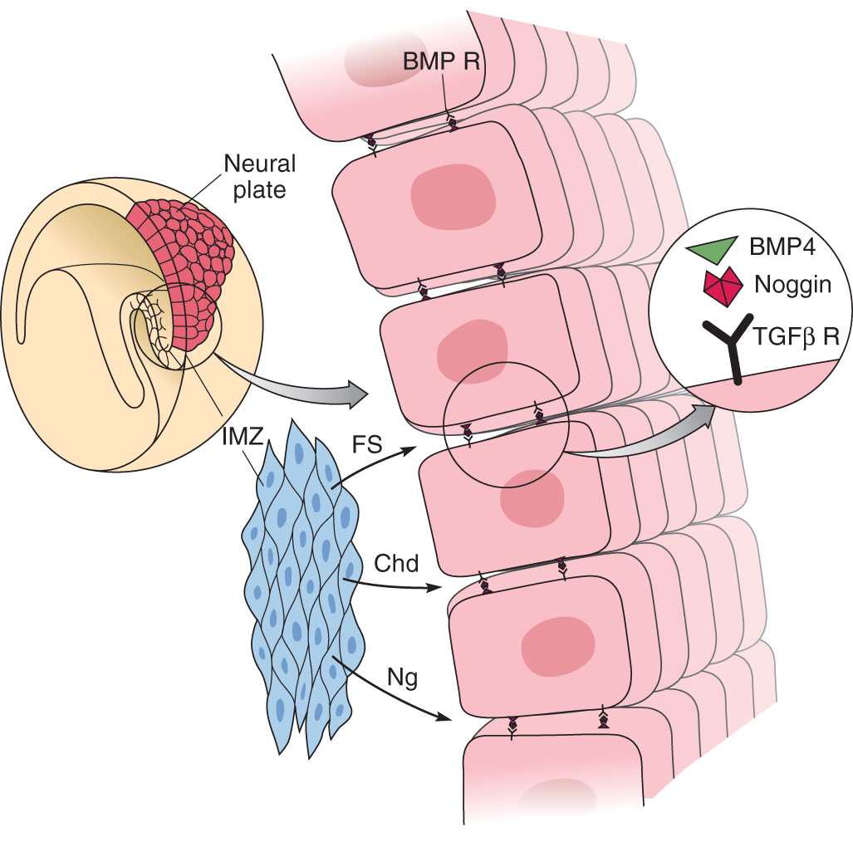
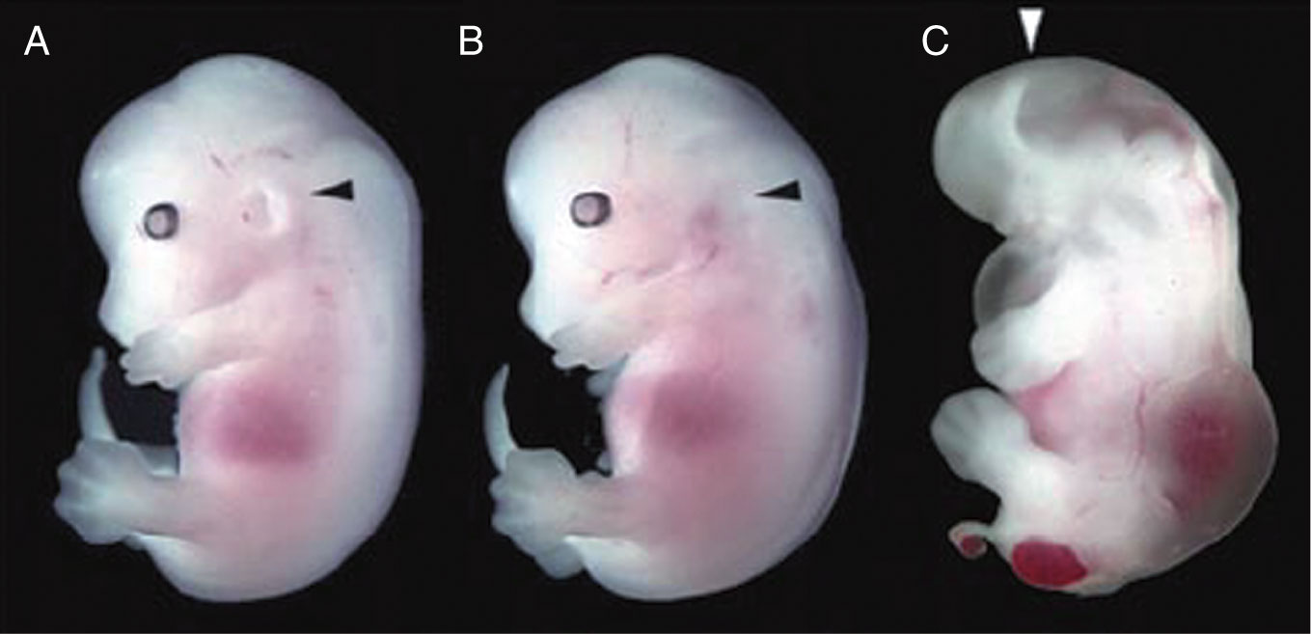

Slide 34
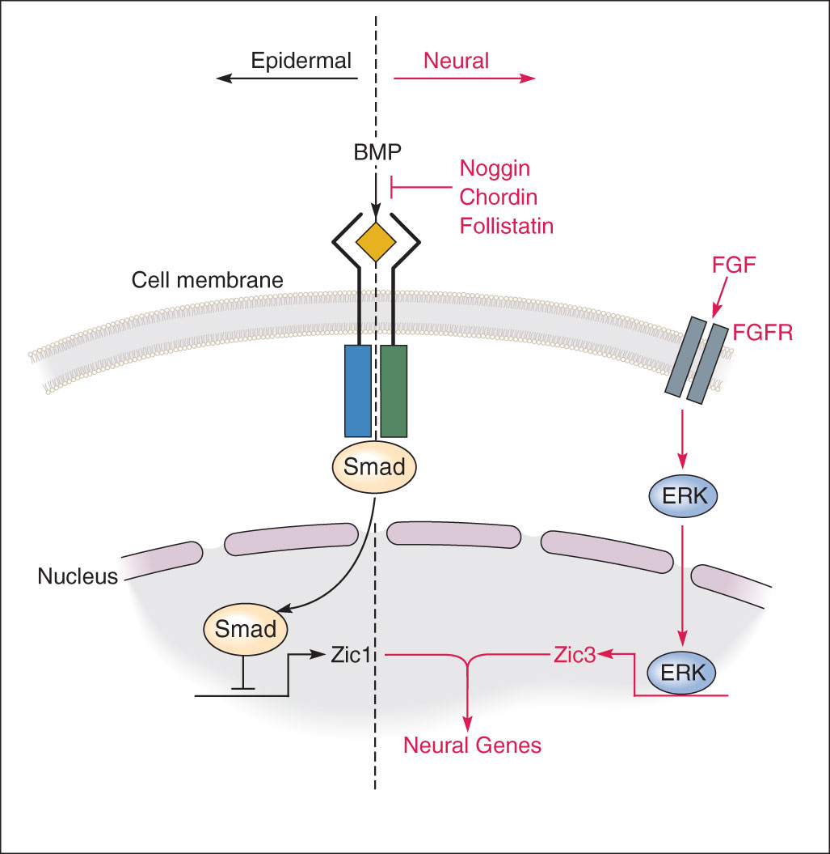
Molecular Interactions in Neural Induction

Slide 35
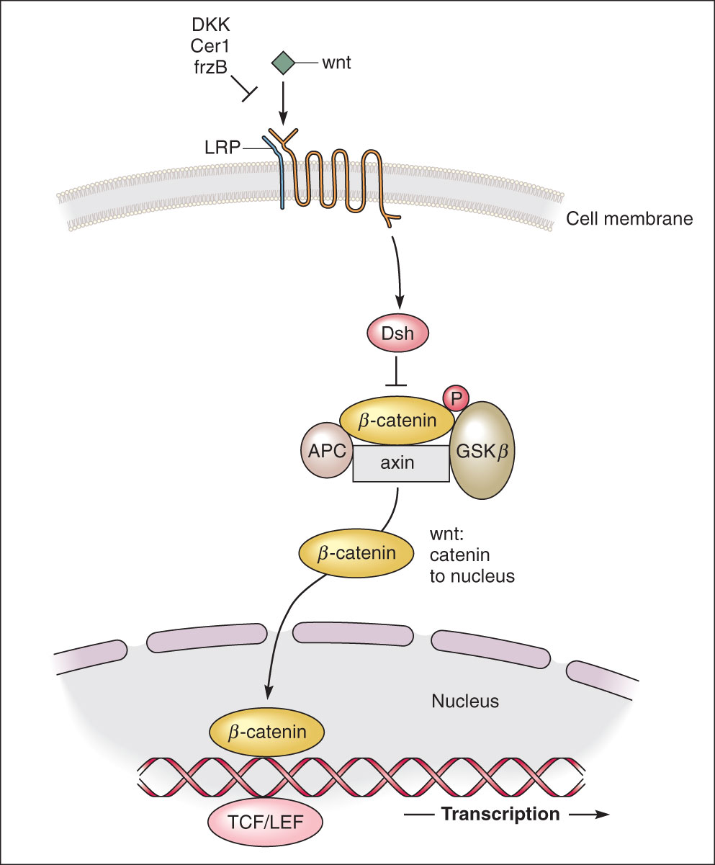
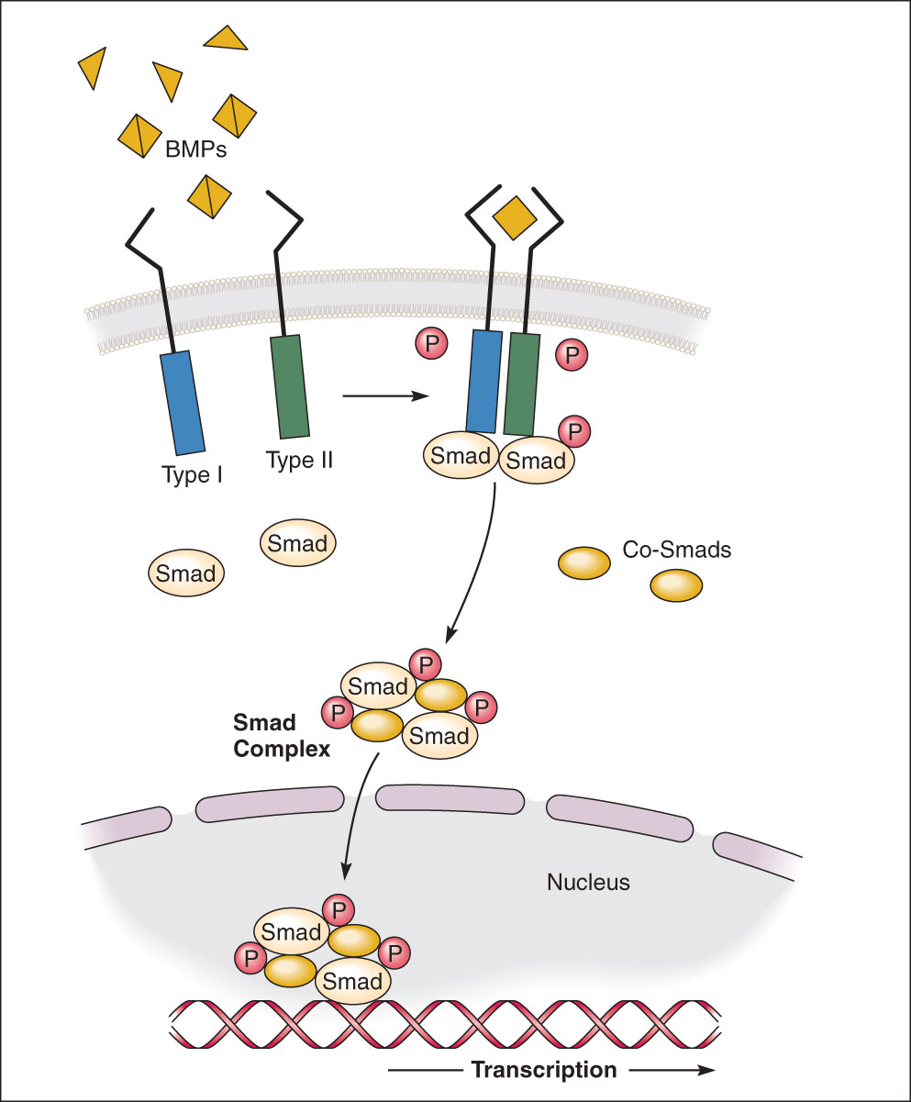
Important Signaling Pathways in Development

Slide 36
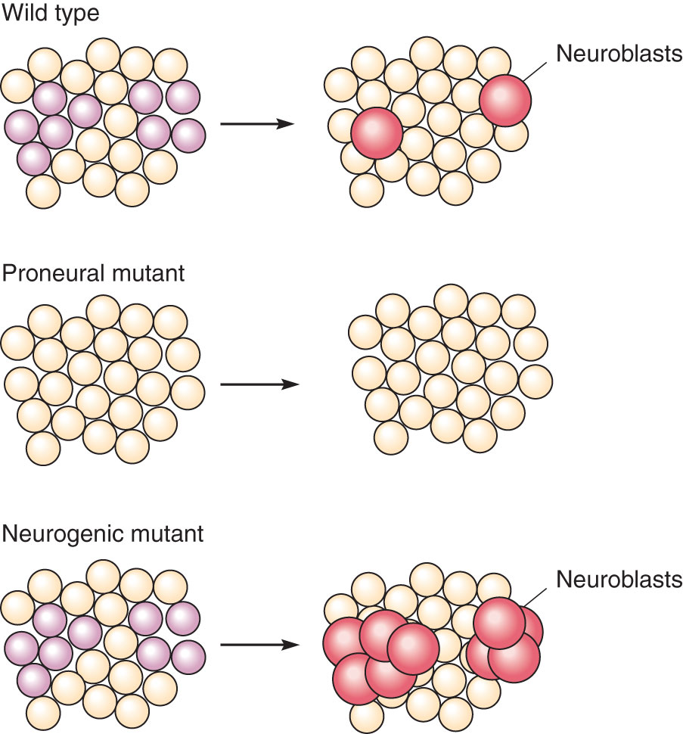
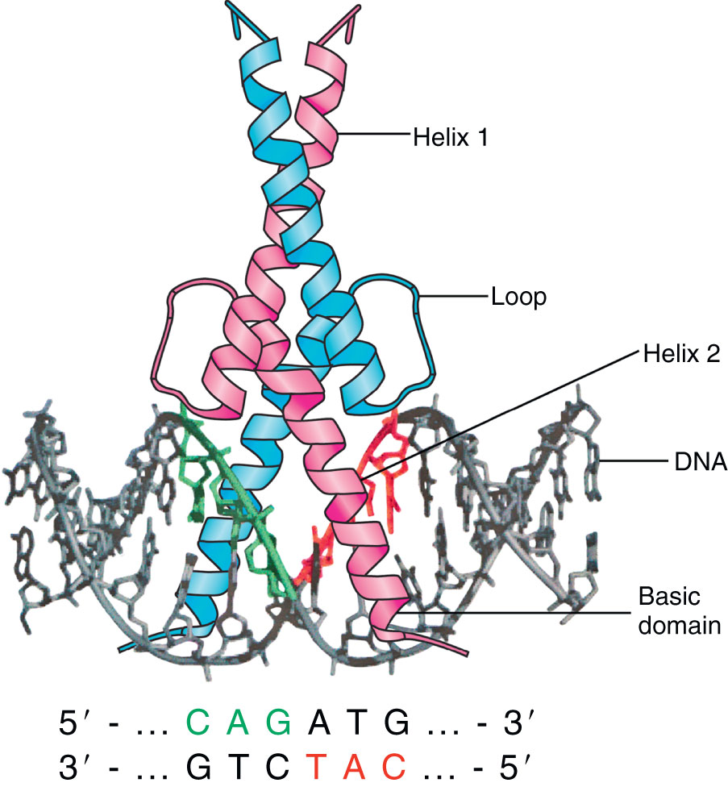
“Proneural” Genes

Slide 37
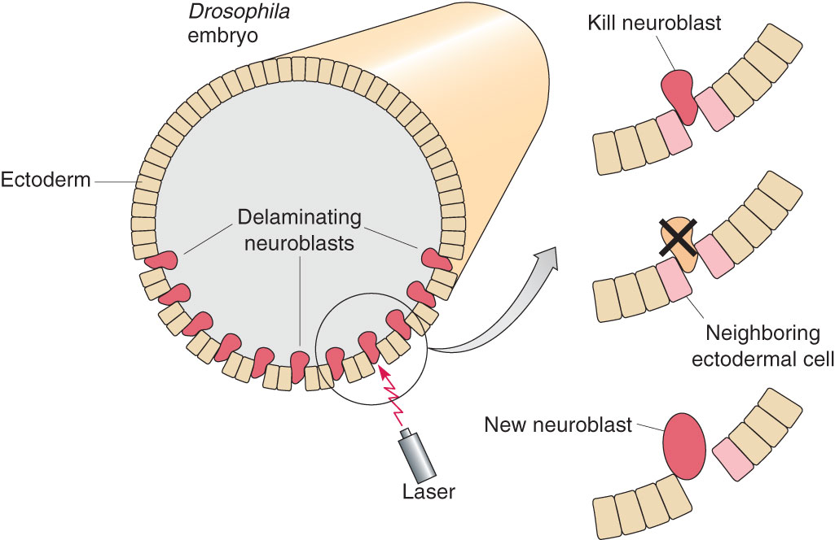
Where are these signals coming from?

Slide 38
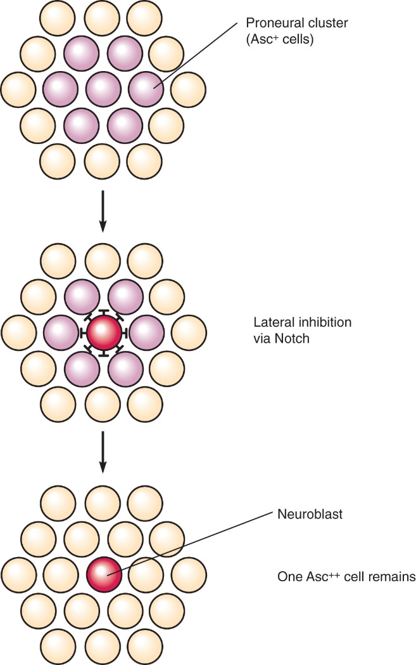
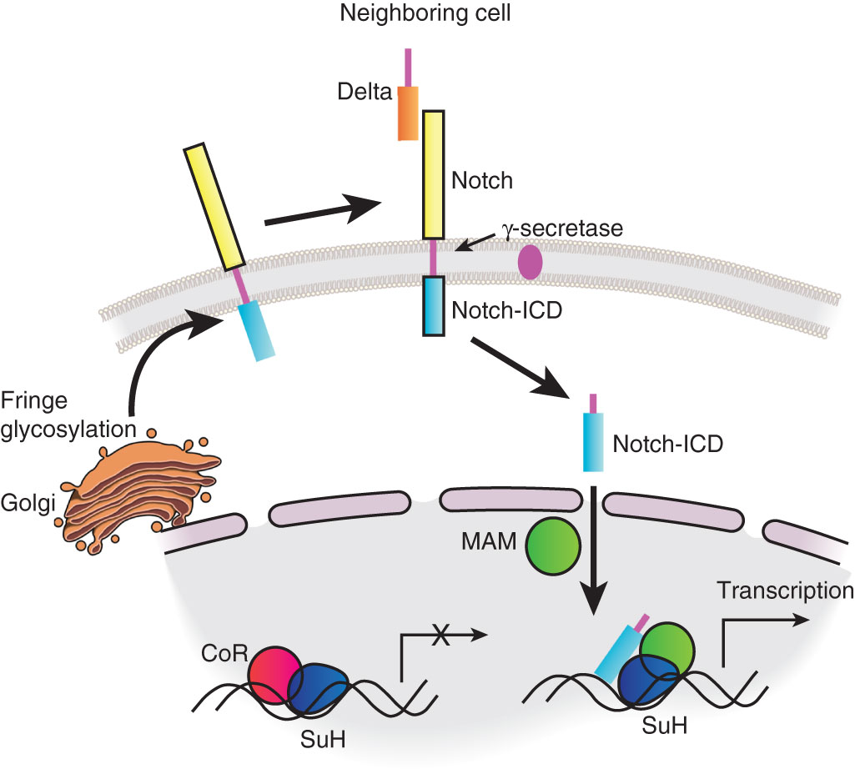
Contact-Dependent Signals

Slide 39

Crosstalk and Feedback Mechanisms

